Slide 1
CSE-316 MICROCONTROLLER project Surveillance DRONE
PROPOSED BY:
MIRZA MASFIQUR RAHMAN(1305035)
FAHIM AHMED(1305053)

Slide 2
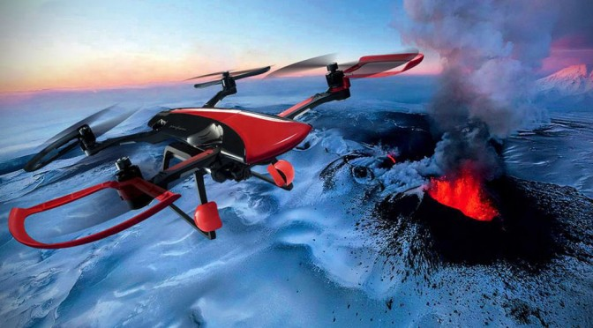
WHAT IS A DRONE ?

Slide 3
A DRONE IS A UAV (UNMANNED AREAL VEHICLE) THAT CAN BE OPERATED REMOTELY BY A PERSON.
NOWADAYS USE OF DRONE HAS EXPANDED ALL OVER THE WORLD.
DRONES ARE USED FOR MANY PURPOSES.

Slide 4
Drones are used in

Slide 5
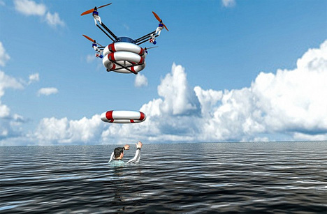
Rescue operation

Slide 6
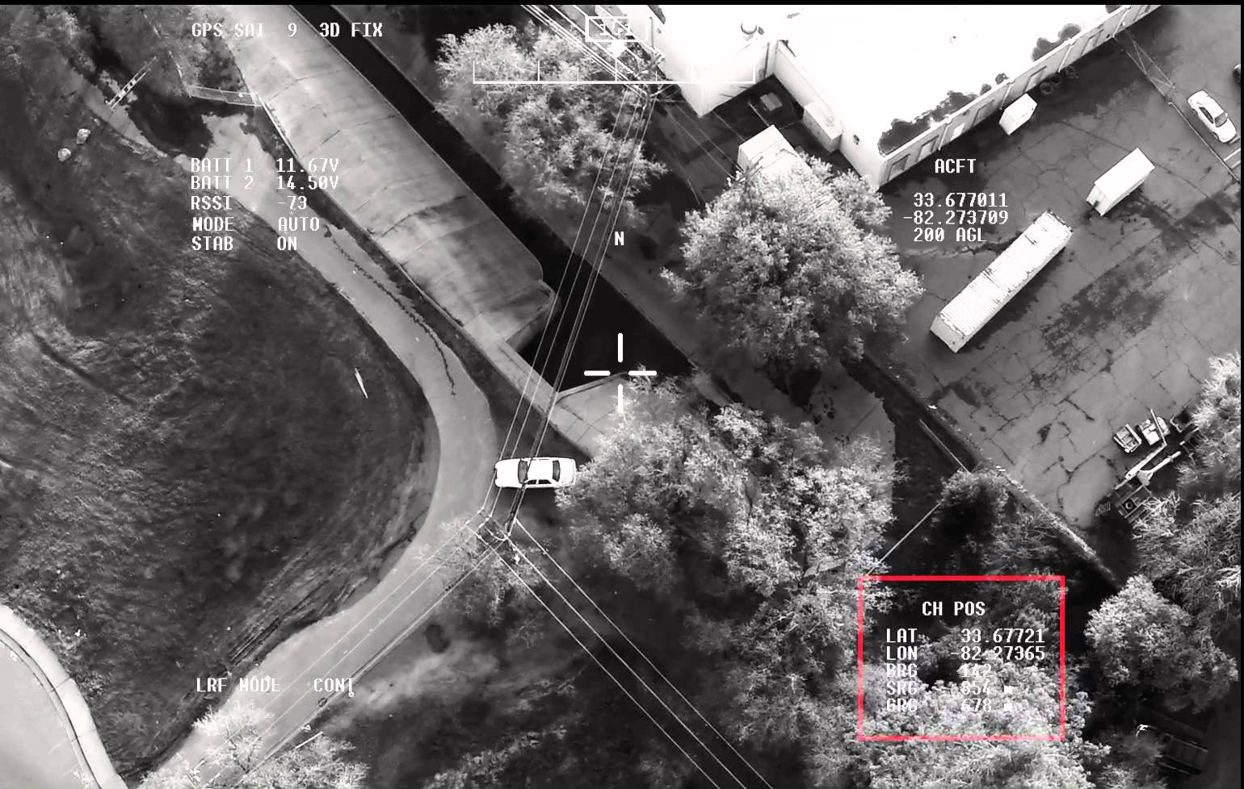
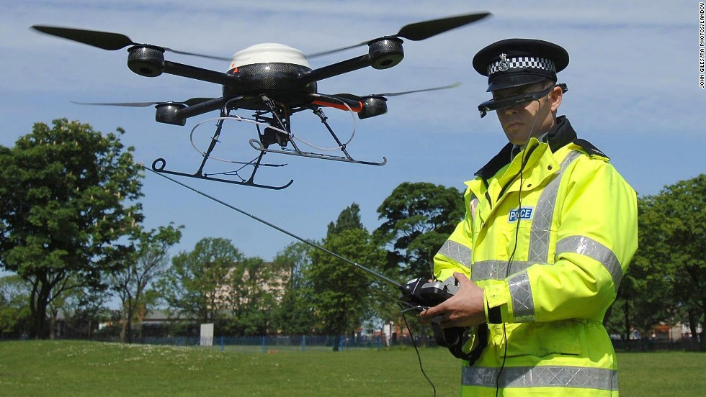
Surveillance

Slide 7
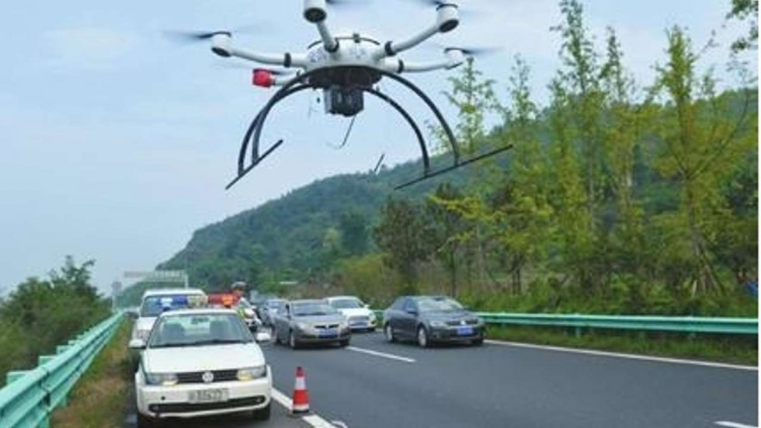
Traffic control

Slide 8
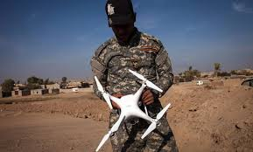
Military operation

Slide 9
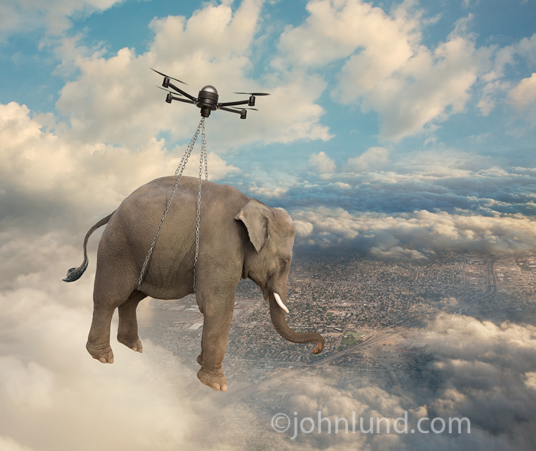
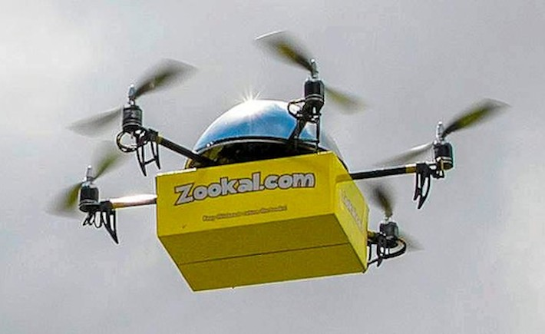
Transportation

Slide 10
And so on…

Slide 11
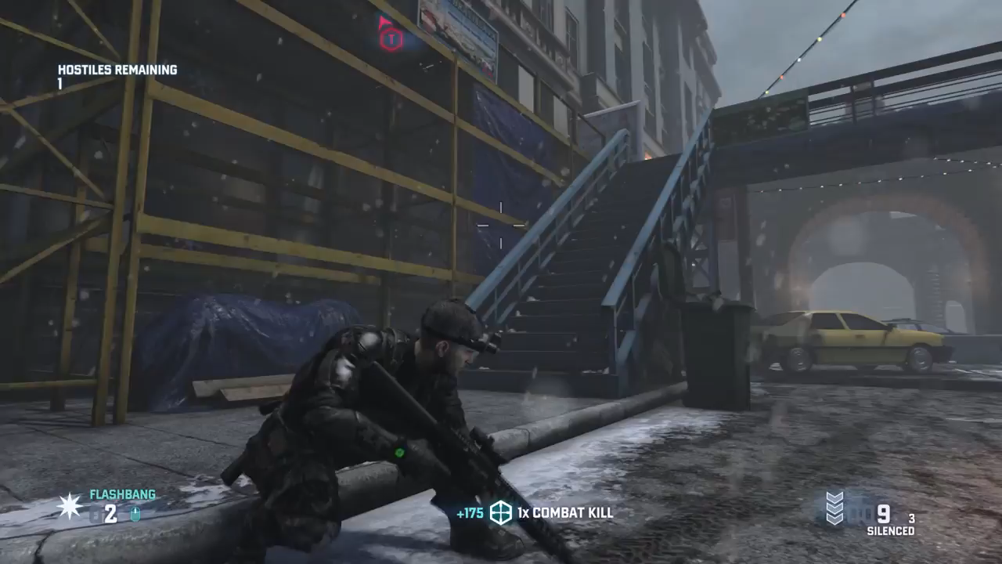

Slide 12
Our project
A SURVEILLANCE DRONE THAT –
WILL BE CONTROLLED REMOTELY.
WILL HAVE A CAMERA ATTACHED TO IT FOR VIDEO TRANSMISSION.
CAN AVOID OBSTACLES ON ITS WAY TO PROTECT ITSELF FROM DAMAGE.

Slide 13
COMPONENTS THAT WILL BE USED
MICROCONTROLLER ATMEGA32
LIPO RECHARGABLE BATTERY 11.2V
BRUSHLESS MOTOR AX-2810Q
ESC (ELECTRONIC SPEED CONTROLLER)
SONAR SENSOR HC-SR04
CAMERA WITH WIRELESS TRASNMITTER
REMOTE CONTROLLER

Slide 14
Implementation details
Mainly the remote controller will be used to control the drone.
But when an obstacle is imminent, the sonar sensors will have higher priority than the controller so that it can avoid crash.
Six sonar sensors will be used to detect forward, backward, right, left, upward and downward obstacles.
Motor will be controlled through ESC. The ESC will be connected to the microcontroller.
If the project is successful, we will try to add a camera for surveillance.

Slide 15
